Slide 1

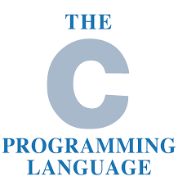

C LANGUAGE
,Mentors: Mamata Das,Prasanta Acharya,Soumyajit Roy,Arijit Banerjee,Avijit Sarker,Nibedita Kumar,Sk Tajel Haque,Kavita Paul and Dip Saha.

Slide 2

Agenda
  Module 1:
  Introduction
  Header Files
  Data types
  Operators

Slide 3
Brief History:
Introduction
The C programming language was designed by Dennis Ritchie at Bell Laboratories in the early 1970s
Influenced by
  ALGOL 60 (1960),
  CPL (Cambridge, 1963),
  BCPL (Martin Richard, 1967),
  B (Ken Thompson, 1970)

Slide 4
Features of C Language
Simple & Powerful
Syntax Based
C Language
Platform
dependent
Structure Oriented
Uses pointers
Case Sensitive

Slide 5
A Simple C Program
Create example file: try.c
Compile using gcc:
gcc –o try try.c
The standard C library libc is included automatically
Execute program
./try
Note, I always specify an absolute path
Normal termination:
#include <stdio.h>
int main (void)
{
printf(“Hello World”);
}

Slide 6
C Standard Header Files
Standard Headers you should know about:
  stdio.h – file and console (also a file) IO: perror, printf, open, close, read, write, scanf, etc.
  stdlib.h - common utility functions: malloc, calloc, etc
  string.h - string and byte manipulation: strlen, strcpy, strcat etc.
  math.h – math functions: ceil, exp, floor, sqrt etc.
  conio.h- contains console & display related functions:
  clrscr(),getch() etc.

Slide 7
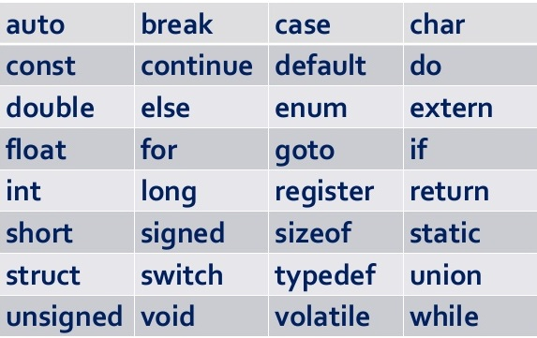
Keywords in C
List of Keywords in C-

Slide 8
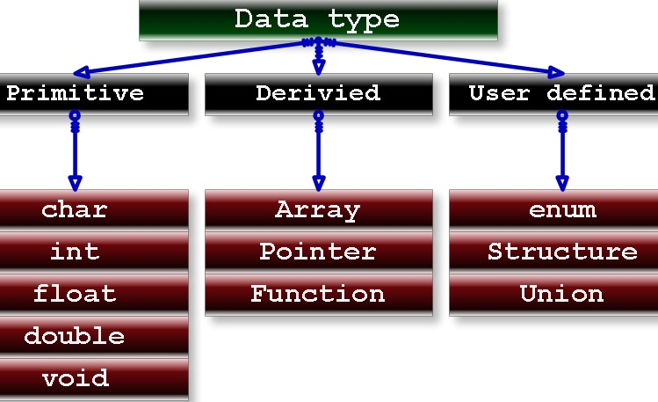
Basic Data Types in C

Slide 9
Basic Data Types
Data Type Example-
#include<stdio.h>
int main(void)
{
int i=2,float f=4.5;
printf(" the value of i=%d",i);
printf(" the value of i=%f",f);
}

Slide 10
Operators
Operators | Symbols | Example
Arithmetic | +,-,*,/,% | A+5
Assignment | =,+=,-=,*=,/=,%= | A=5
Relational | ==,>,<,<=,>= | A>5
Logical | &&,|| | (a>=1&&a<=10)
Bitwise | <<,>>,&,| | (110<<2)=101

Slide 11
Flow chart,algorithm and program
Start
#include<stdio.h>
int main(void)
{
int a=2,b=5,sum=0;
sum =a+b;
printf(" sum is %d",sum);
}
Start
Declare two variables a & b.
Declare a variable Sum for storing the result.
Add a & b.
Store result in Sum.
Print sum.
Stop
Read a,b,Sum=0
Sum=a+b
Print sum
stop
Flow chart Algorithm Program

Slide 12
Agenda
  Module 2:
  If-else Statements
        If
        If-else
        If-else ladder
        If-else nested
  Switch Case

Slide 13
If-Else Statement
Start
#include <stdio.h>
#include <conio.h>
Void main()
{
int a=10,b=20;
if (a < b)
printf(“a is less than 10\n”);
else if (a == b)
printf(“a is 10\n”);
else
printf(“a is greater than 10\n”);
}
Read a,b
Is a>b
no
Print b
yes
Print a
Stop
Flow chart Program

Slide 14
Switch case
#include<stdio.h>
int main(void)
{
int i=0;
switch(i)
{
case 1:
printf("value of i is 1");
break;
case 2:
printf("value of i is 2");
break;
case 3:
printf("value of i is 3");
break;
case 4:
printf("value of i is 4");
break;
default:
printf("this is default");
break;
}
}
Start
Read i=0
Case 1
Print 1
Case 2
Print 2
Case 3
Print 3
Case 4
Print 4
Stop

Slide 15
Agenda
  Module 3:
  Loops
        While
        Do While
        For

Slide 16
Loops
Start
Read a=1
i<=10
i=i+1
Print a
Stop
flow control
  break – exit innermost loop
  continue – perform next iteration of loop

Slide 17
While Loop Example
Start
#include<stdio.h>
int main(void)
{
int i=1;
while(i<10)
{
printf("value of i is %d",i);
i++;
}
}
Read i=1
while i<10
No
Exit the loop
yes
Print i
i++
Stop

Slide 18
Do-While Loop Example
Start
#include<stdio.h>
int main(void)
{
int i=1;
do
{
printf("value of i is %d",i);
i++;
}
while(i<10);
}
Read i=1
Print i
yes
while i<10
no
Exit the loop
i++
Stop

Slide 19
For Loop Example
Start
#include<stdio.h>
int main(void)
{
int i=1;
for(i=1;i<10;i++)
{
printf ("the values of i are %d\n",i);
}
}
Read i=1
If i<10
no
yes
Stop
Print i
i++

Slide 20
Agenda
  Module 4:
  Functions
  Strings

Slide 21
Functions
The function in C language is also known as procedure or subroutine in other programming languages.
To perform any task, we can create function. A function can be called many times. It provides modularity and code reusability.
Always use function prototypes :
int myfunc(float,int[]);//function assignment
void myfunc(int);
Function calling :
  myfunc(a); // calling a function
  myfunc(i, f);
  Function declaration :
  void myfunc(int a){} // declaration a function
  int myfunc(float f,int i[]){}

Slide 22
Function Example
#include<stdio.h>
int sum(int,int);
int main(void)
{
int a=5,b=10,s;
s=sum(a,b);
printf("value of sum is %d",s);
}
int sum(int i, int j)
{
int s;
s=i+j;
return s;
}

Slide 23
Strings
Strings are actually one-dimensional array of characters terminated by a null character '\0'. Thus a null-terminated string contains the characters that comprise the string followed by a null.
Following is the memory presentation of the above defined string in C-
0 | 1 | 2 | 3 | 4 | 5
H | e | l | l | o | \0

Slide 24
String Functions
strcpy(s1,s2)-copies string s2 into s1.
strcat(s1,s2)-concatenates string s2 to end of string s1.
strlen(s1)-returns length of string s1.
strcmp(s1,s2)-returns zero if s1 & s2 are same.
strchr(s1,ch)-returns a pointer to occurrence of ch in s1.
strstr(s1,s2)-returns a pointer to occurrence of s2 in s1.
strrev(s1)-returns a reversed order of a given string s1.
strlwr(s1)-converts a given string s1 to lowercase.
strupr(s1)-converts a given string s1 to uppercase.

Slide 25
String Example
#include <stdio.h>
#include <string.h>
int main () {
char str1[12] = "Hello";
char str2[12] = "World";
char str3[12];
int len ;
/* copy str1 into str3 */
strcpy(str3, str1);
printf("strcpy( str3, str1) : %s\n", str3 );
/* concatenates str1 and str2 */
strcat( str1, str2);
printf("strcat( str1, str2): %s\n", str1 );
/* total length of str1 after concatenation */
len = strlen(str1);
printf("strlen(str1) : %d\n", len );
return 0;
}

Slide 26
Agenda
  Module 5:
  Arrays
  Pointers

Slide 27
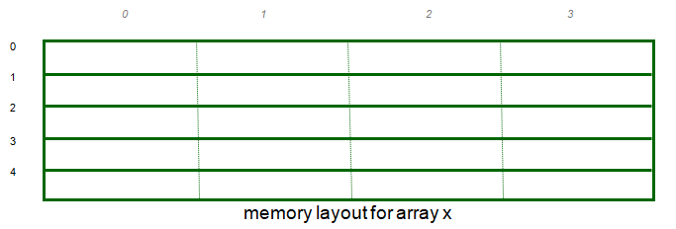
Arrays
A variable declared as an array represents a contiguous region of memory in which the array elements are stored.
  int x[5]; // an array of 5 4-byte ints.
All arrays begin with an index of 0

Slide 28
Array Example
#include<stdio.h>
int main(void)
{
int arr[5]={10,20,15,25,35};
for(i=0,i<5;i++)
{
printf("the array is %d",arr[i]);
}
}

Slide 29
Agenda
  Module 6:
  Pointers Contd….
  Structures

Slide 30
Pointers
For any type T, you may form a pointer type to T.
  Pointers may reference a function or an object.
  The value of a pointer is the address of the corresponding object or function
  Examples: int *i; char *x; int (*myfunc)();
Pointer operators: * dereferences a pointer, & creates a pointer (reference to)
  int i = 3; int *j = &i;
  *j = 4; printf(“i = %d\n”, i); // prints i = 4
  int myfunc (int arg);
  int (*fptr)(int) = myfunc;
  i = fptr(4); // same as calling myfunc(4);
Generic pointers:
  Traditional C used (char *)
  Standard C uses (void *) – these can not be dereferenced or used in pointer arithmetic. So they help to reduce programming errors
Null pointers: use NULL or 0. It is a good idea to always initialize pointers to NULL.

Slide 31
Pointers in C (and C++)
Program Memory
Address
Step 1:
int main () {
int x = 4;
int *y = &x;
int *z[4] = {NULL, NULL, NULL, NULL};
int a[4] = {1, 2, 3, 4};
...
x
4
0x3dc
y
0x3dc
0x3d8
NA
0x3d4
NA
0x3d0
z[3]
0
0x3cc
z[2]
0
0x3c8
z[1]
0
0x3c4
z[0]
0
0x3c0
a[3]
4
0x3bc
a[2]
3
0x3b8
a[1]
2
0x3b4
a[0]
1
0x3b0

Slide 32
Structure
Structure in c language is a user defined
datatype that allows you to hold different type of
elements.
Each element of a structure is called a
member.
It is widely used for storing information on
Students , employees ,products etc.
Defining structure-
The struct keyword is used to define structure.

Slide 33
Structure Example
#include<stdio.h>
#include <string.h>
struct employee
{ int id;
char name[50];
}e1; //declaring e1 variable for structure
int main( )
{
//store first employee information
e1.id=101;
strcpy(e1.name, “PCS Global ");//copying string into char array
//printing first employee information
printf( "employee 1 id : %d\n", e1.id);
printf( "employee 1 name : %s\n", e1.name);
return 0;
}

Slide 34
Agenda
  Module 7:
  Basic Data Structure
  > Concepts Of FIFO(Queue)
  >Concepts Of LIFO (Stack)
  2. Sorting

Slide 35
Data Structure
What is Data Structure?
Data Structure is a way of collecting and organising data
in such a way that we can perform operations on these
data in an effective way. Data Structures is about
rendering data elements in terms of some relationship,
for better organization and storage.

Slide 36
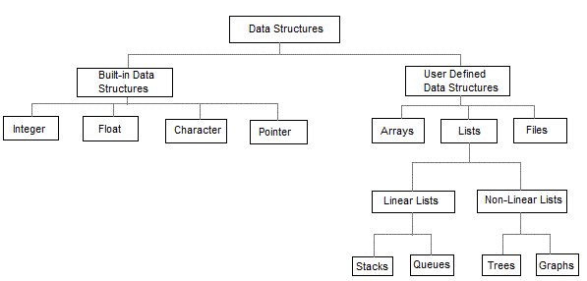
Data Structure in C

Slide 37
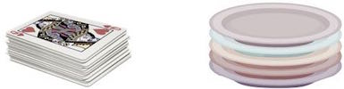
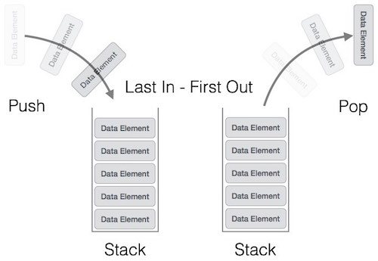
Stack
Operations in Stack-
1.pop()-adds element to Top of Stack.
2.push()-removes element from Top of Stack.

Slide 38
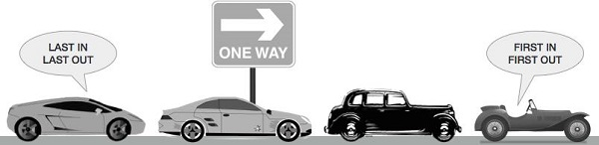
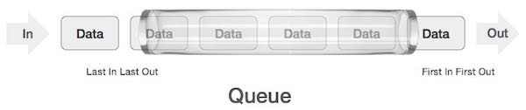
Queue
Operations in Queue-
1.enqueue() − add (store) an item to the rear of queue.
2.dequeue() − remove (access) an item from the front of queue.

Slide 39
Sorting
Sorting is nothing but storage of data in sorted order, it can be in ascending or descending order. The term Sorting comes into picture with the term Searching. There are so many things in our real life that we need to search, like a particular record in database, roll numbers in merit list, a particular telephone number, any particular page in a book etc.
Types of sorting
Bubble sort
Insertion sort
Selection sort
Merge sort
Quick sort

Slide 40
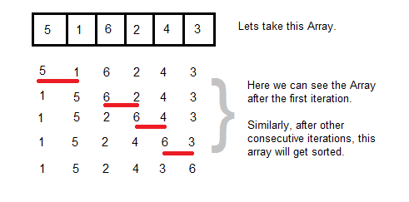
Bubble Sort
Bubble Sort is an algorithm which is used to sort N elements that are given in a memory.
It is called Bubble sort, because with each iteration the largest element in the list bubbles up towards the last place, just like a water bubble rises up to the water surface.

Slide 41
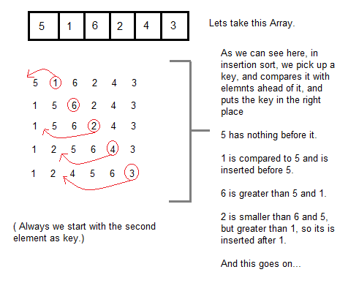
Insertion Sort
It is a simple Sorting algorithm which sorts the array by shifting elements one by one.

Slide 42
Agenda
  Module 8:
  Searching

Slide 43
Searching
The process of finding particular element in an array is called searching.
Types of searching-
Searching
Linear Search
Interpolation
Search
Binary Search

Slide 44
Thank You

